Slide 1
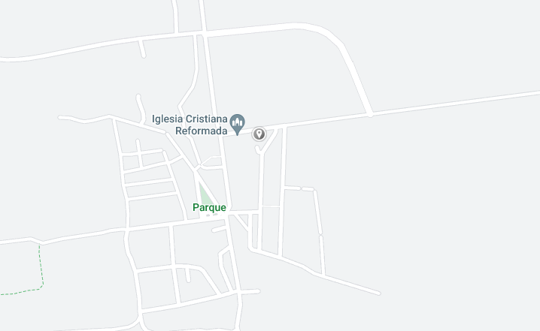

calle 14 No 1712 e/ 17 y 21
+53 52185109
farmpedroso@gmail.com
8:30hrs a 17:00 hrs

